Slide 1

Political Culture In Bangladesh

Slide 2

Group Member
A.F.M. RAFIUL HASSAN
(22-47048-1)
MD. ASHIKUZZAMAN ABIR
(22-47006-1)
MD. JAHID HASAN
(22-47010-1)
NILADRI BISWAS RIVA
ID: 22-47834-2
SANJUKTA DAS
ID :22-47801-2
MD. EMRAN NAZIR EFTY
ID: 22-47802-2
TUTUL KUMAR GHOSH
ID: 22-47813-2

Slide 3
OUTLINE
Detailed Overview of The Political Culture in Bangladesh (2008-2023)
What Is Politics?
Introduction
Challenges in the Political Culture
Political Party
Potential Solutions
Current Political Scenario in Bangladesh
Impacts Of Politics in Bangladesh
Development works of the ruling party as government
Challenges to Implementing Solutions
Criticism of Current Political Culture
Conclusion

Slide 4

What Is Politics?
Politics are the actions or activities concerned with achieving and using power in country or society

Slide 5

Introduction
Bangladesh's political culture witnessed a range of developments, challenges, and dynamics that shaped the nation's governance, social interactions, and economic progress. This period encompassed democratic transitions, political polarization, social movements, and efforts towards economic development.

Slide 6
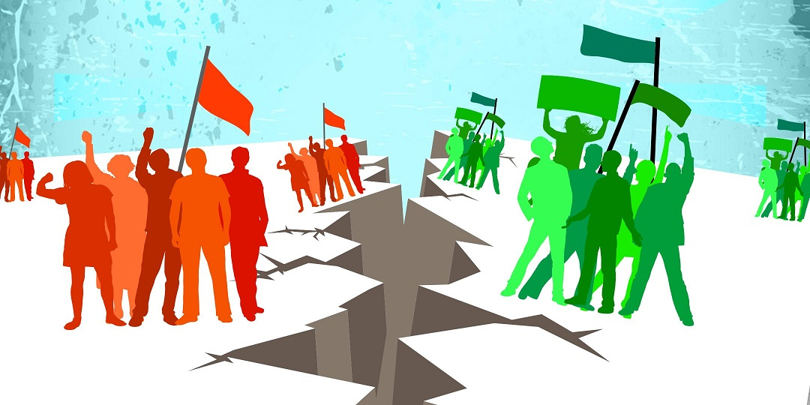
Political Party
Major Parties (3)
Minor Parties (39)

Slide 7
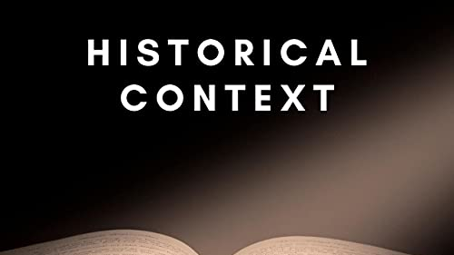
Bangladesh's political culture has a strong historical foundation. After a lengthy fight for independence, the nation was freed from Pakistan in 1971. This historical occurrence significantly contributes to the formation of the national identity and the promotion of pride and cohesion among the populace. The tragedy of the Liberation War still has an impact on political dynamics, underlining the value of democratic values and self-governance.

Slide 8
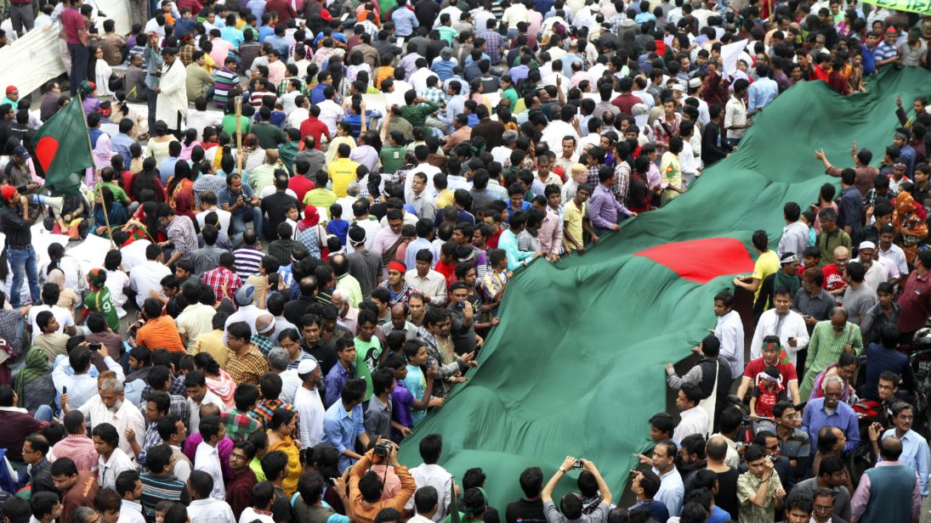
Current Political Scenario in Bangladesh
Ruling party:
Awami League
Opposition party:
Jatiya Party
Parliament:
11th national parliament.
Duration of ruling party:
Forming government since 2009

Slide 9
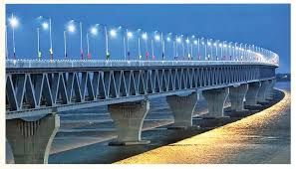
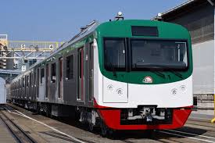
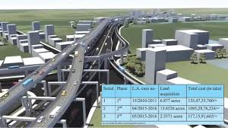
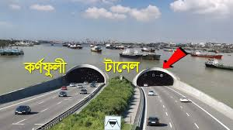
Development works of the ruling party as government
Padma Bridge
Metro Rail
Dhaka Elevated Expressway
Bangabandhu Sheikh Mujibur Rahman Tunnel

Slide 10
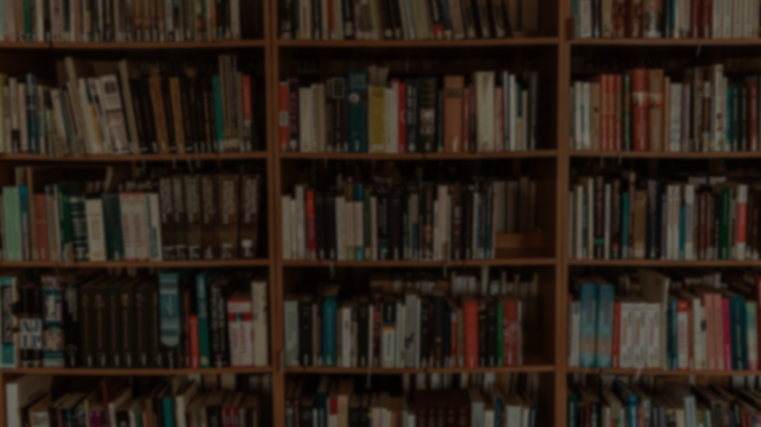
Criticism of Current Political Culture
Religious Extremism: Bangladesh has been grappling with the rise of religious extremism in recent years.
Money in politics: The influence of money in politics is a major problem in Bangladesh.
Growing power of the military: The military has played a significant role in Bangladeshi politics in the past.
Erosion of democratic norms and institutions: There have been concerns about the erosion of democratic norms and institutions in Bangladesh in recent years.

Slide 11
Detailed Overview of The Political Culture in Bangladesh (2008-2023)

Slide 12

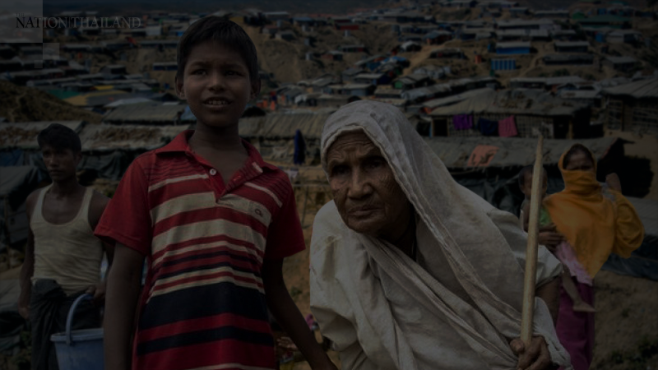
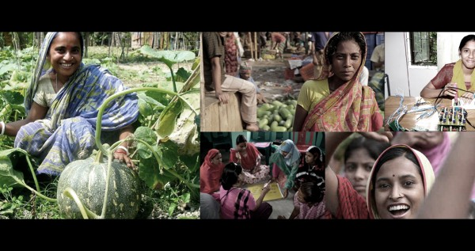
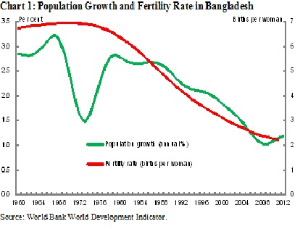
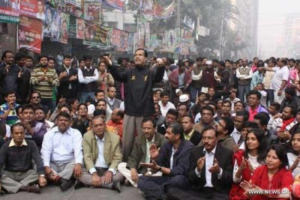
Democratic Transition and Early Years (2008-2013)
Political Turmoil and Controversies (2013-2018)
Economic Development and Infrastructure Projects (2010s)
Rohingya Crisis and Regional Dynamics (2017-2023)
Women's Empowerment and Social Initiatives (2010s-2023)
In 2008, Bangladesh transitioned to democracy after a period of military-backed caretaker rule. The Awami League, led by Sheikh Hasina, won a landslide victory in the general elections.
The return to democratic governance marked a significant step towards establishing institutional stability and democratic norms.
V
The government launched various economic development projects and initiatives to improve infrastructure, connectivity, and living standards.
Mega-projects such as the Padma Bridge, metro rail systems, and Special Economic Zones aimed to stimulate economic growth and enhance trade and commerce.
IV
The 2014 general elections were marked by controversy as the BNP and its allies boycotted the polls, raising concerns about the legitimacy of the electoral process.
The Rohingya refugee crisis, which began in 2017 due to the persecution of Rohingya Muslims in Myanmar, had significant implications for Bangladesh's political and social fabric.
Bangladesh provided shelter to a large number of Rohingya refugees, leading to discussions about the country's humanitarian efforts, international relations, and regional diplomacy.
Bangladesh made strides in women's empowerment, with increased representation of women in politics, education, and the workforce.
III
The government faced criticism over issues such as press freedom, restrictions on freedom of expression, and allegations of extrajudicial actions by law enforcement agencies.
II
I

Slide 13

Political Polarization
Violation of Human Rights
Deep divide between major parties leads to gridlock and violence.
Human rights abuses persist.
Challenges in the Political Culture
Lack of Civic Education
Corruption
Citizens lack understanding of democratic processes.
Widespread corruption hampers growth and erodes trust.
Lack of Political Accountability
Youth Engagement
Leaders often avoid accountability.
Youth feel excluded.

Slide 14

Promotion of Dialogue
Promoting Civic Education
Encourage open and inclusive talks between political parties
Integrate civic education in schools, raise awareness about rights and responsibilities.
Potential Solutions
Transparency and Accountability
Media Freedom
Ensuring press freedom and protecting journalists' rights to report without fear of reprisal is crucial for a vibrant democracy.
Strengthen independent institutions, enable citizen participation, allow recalls

Slide 15

Civil Society Engagement
Encouraging civil society organizations, non-governmental organizations (NGOs), and citizen-led initiatives can play a role in promoting democratic values and advocating for positive change.
Potential Solutions
Economic Development
Addressing socioeconomic disparities and improving the living conditions of the population can reduce the appeal of radical ideologies and promote stability.
Youth Engagement
Engaging the youth through education, employment opportunities, and participation.

Slide 16

Impacts Of Politics in Bangladesh
Politics has had a significant impact on Bangladesh, influencing its economic, social, and cultural landscape. The country has experienced periods of political instability, which at times have hindered development and governance. Factors such as political polarization, corruption, and lack of effective governance have sometimes led to challenges in maintaining stability and promoting progress. However, politics has also played a role in shaping policies, infrastructure development, and international relations, contributing to the country's growth and global engagement.

Slide 17

Challenges to Implementing Solutions
Overcoming resistance from powerful individuals
One of the biggest challenges in implementing solutions to improve Bangladesh's political culture is overcoming resistance from powerful individuals and groups who benefit from the current system. These individuals and groups may use their influence to block reforms or undermine efforts to increase transparency and accountability.
Changing the attitudes and behaviors of ordinary citizens
Another challenge is changing the attitudes and behaviors of ordinary citizens, many of whom have become disillusioned with politics and may not see the value in participating in reform efforts. Educating and mobilizing these citizens will be crucial in building momentum for change.

Slide 18

Conclusion
The political culture of Bangladesh is a reflection of its history, values, and aspirations. While challenges such as political polarization, violence, and governance issues persist, there are clear prospects for positive change. By promoting dialogue, strengthening institutions, empowering citizens, and fostering an environment of accountability, Bangladesh can overcome its challenges and pave the way for a more inclusive, prosperous, and democratic future.

Slide 19


